Slide 1
Fake Report Detection
Project Plan
Gianscal Yu 2018.04

Slide 2
Content
Background
Current Situation
RoadMap
Expectation

Slide 3
Background
At the oversea market user can report broken bike which can help us find and repair the broken bike rapidly.
Our bike operator will find bike by the guide of report info.
If user generate a lot of fake report, our operator will pay useless searching work by the misleading of the fake info.
Every report including many related data like bike route or which user, so we thought dig these fake report out by using machine learning.

Slide 4
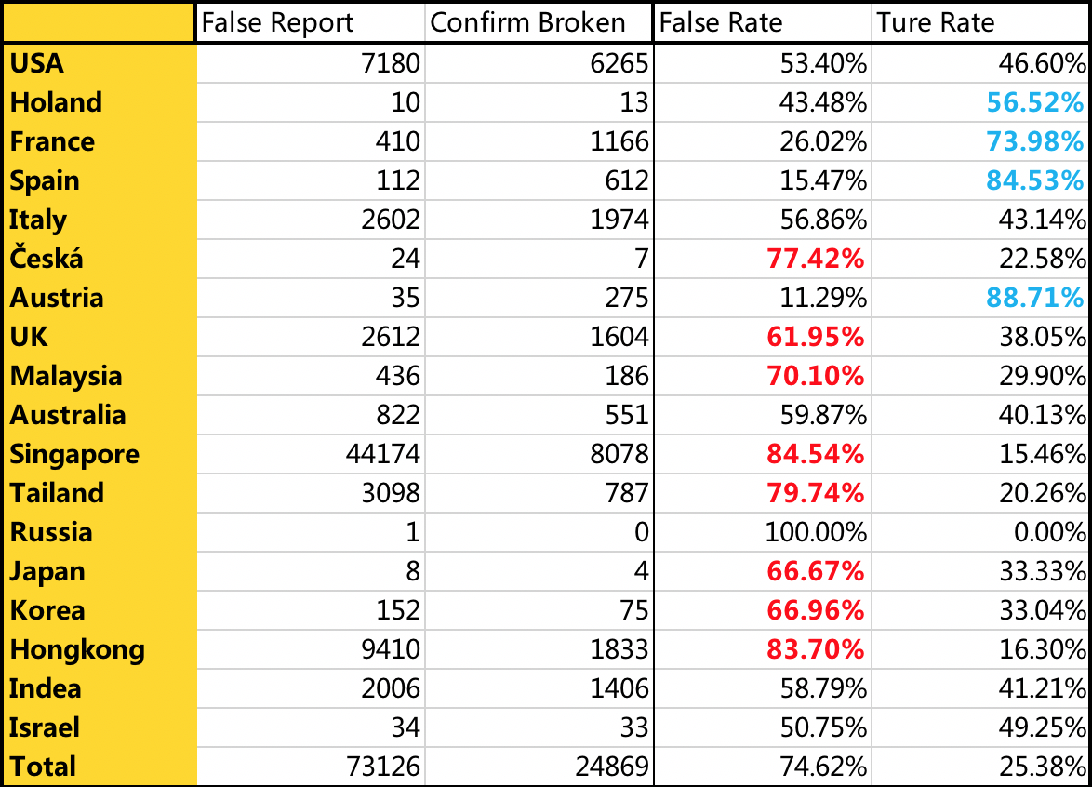
Current Situation
More than 80% country false report was more than 50%
Total false report rate is 74.62%
We have accumulate more than 100,000 data

Slide 5
RoadMap
Data Collecting
Feature Engineering
Model Training & Verification
Data analyzing & optimizing
Releasing plan

Slide 6
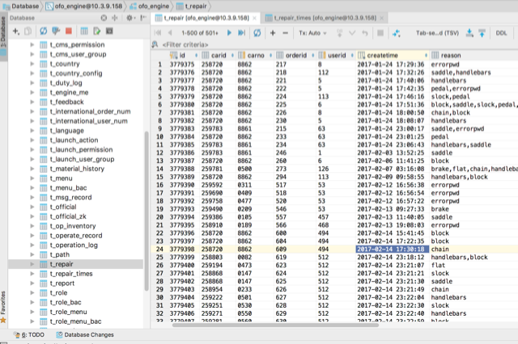
Data Collecting
Report n - 1 Bike n-n User 1-n Order
Stored at business side database
Hundreds of feature dimension estimated
Report
n
1
Bike
n
1
n
n
User
1
n
Order

Slide 7
Feature engineering
Report data
Report time, Reported broken part ……
User data
Age, Nationality, bike pass, ride times, Historical accuracy of report ......
Order data
Last order riding time, Last order end type ......
Bike data
Series, Lock version, Last X report time, Last X report accuracy, First order time......

Slide 8
Model Training & Verification
Supervised learning - clear labeled data
Classification problem - is fake or not
Algorithm
Logistic Regression : J(θ)=−1m∑i=1m[yilog(hθ(xi))+(1−yi)log(1−hθ(xi))]
Naive Bayesian (optional)
SVM (optional)
Deep learning (optional)
ToolKits
Python
Numpy & Pandas
Matplotlib & Seaborn
Scikit-learning

Slide 9
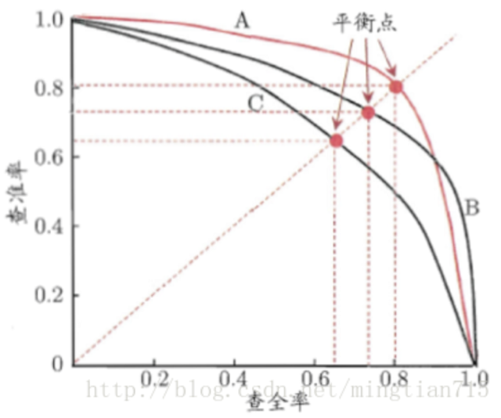
Data analyzing & optimizing
Effect measurement
Precision > Recall Scenario
Fα=（α^2+1）PR/(α^2 P+R)
AUC & ROC
More features
Riding time
Weather related
Topography related
Building related

Slide 10
Releasing plan
Period 1
Release system check online accuracy
Period 2
Show confidence value on engine and help operator make decision
Auto mark broken bike if confidence value is more than selected threshold

Slide 11
Expectation
Baseline
90%+ Precision with 50%+ coverage
Future planning
Removing reported feature and check if the model still work fine for unreported bike
Check all bike with model and discover broken bike automatically

Slide 12
Thanks ~ ^_^

